Slide 1
Mandarin-Phonetic-Symbol Communication Aid on Tablet PC for Children with High-Functioning Autism
Tamkang University, Taiwan
Jia-Sheng You
Notes:
Good day to you all.
Thank you for your interest in my presentation.
My name is Jia,Sheng-You, a student from CILab in TKU.
Today, I’m going to give a talk on the Mandarin-Phonetic-Symbol Communication Aid on Tablet PC for Children with High-Functioning Autism

Slide 2
Outline
1. Introduction
2. Method
3. Results & Conclusions
Notes:
I’d like to conduct my presentation in the sequence shown on this slide.
First, I will give an introduction of Autism Communication briefly
and method will be mentioned.
final is the benefit and results.

Slide 3
Introduction

Slide 4
Introduction
Children with autism often have the following obstacles :
Interpersonal relationship and social interaction.
Verbal communication.
Repetitive behavior.
Notes:
Children with autism often have the following obstacles :
Difficulty in social
Verbal communication.
Repetitive behavior.

Slide 5
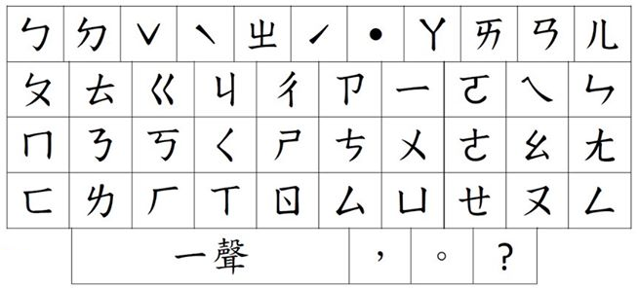
Introduction
For inarticulate children, their messages tend to be misunderstood.
Paper keyboards
But many children can use paper keyboard to express ideas.
http://youtu.be/dJdPknL4P74?t=17s
Notes:
And their message is often misunderstood
But many children can use paper keyboard to express ideas.
this is the usage of paper keyboard .
Teachers are helping child to communicate using a keyboard.
Child's hand is their own sense of movement.

Slide 6
Introduction
The disadvantages of Paper keyboards :
No audio feedback.
Must memorize several consecutive and coherent words.
It’s prone to press the wrong key.
Teacher costs time to communicate with each child respectively
Notes:
But it has some drawbacks
No audio feedback.
Enter the words must be memorized
Easy to press the wrong key
Teachers must spend time communicating with each child

Slide 7
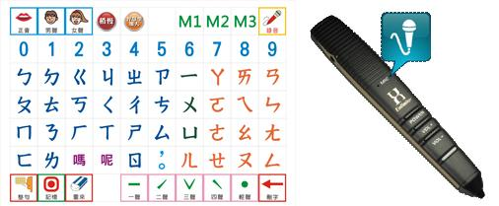
Introduction
In addition, a communication pen (U-pen) can help children to communicate.
communication pen (U-pen)
http://youtu.be/HZuwZOoEObA
Notes:
In addition, you can also buy a communication pen.(U-Pen)
this is the usage of communication pen.

Slide 8
Introduction
Users use this pen to click on a list of Mandarin phonetic symbols.
The pen subsequently produces a sound based on the selected phonetic symbols.
However, the pen costs between U.S. $ 330 to U.S. $ 1,000 for the average family is not a small fee.
Notes:
If you click on the keyboard using a pen
Pen will send the corresponding sound
But the price is too Expensive

Slide 9
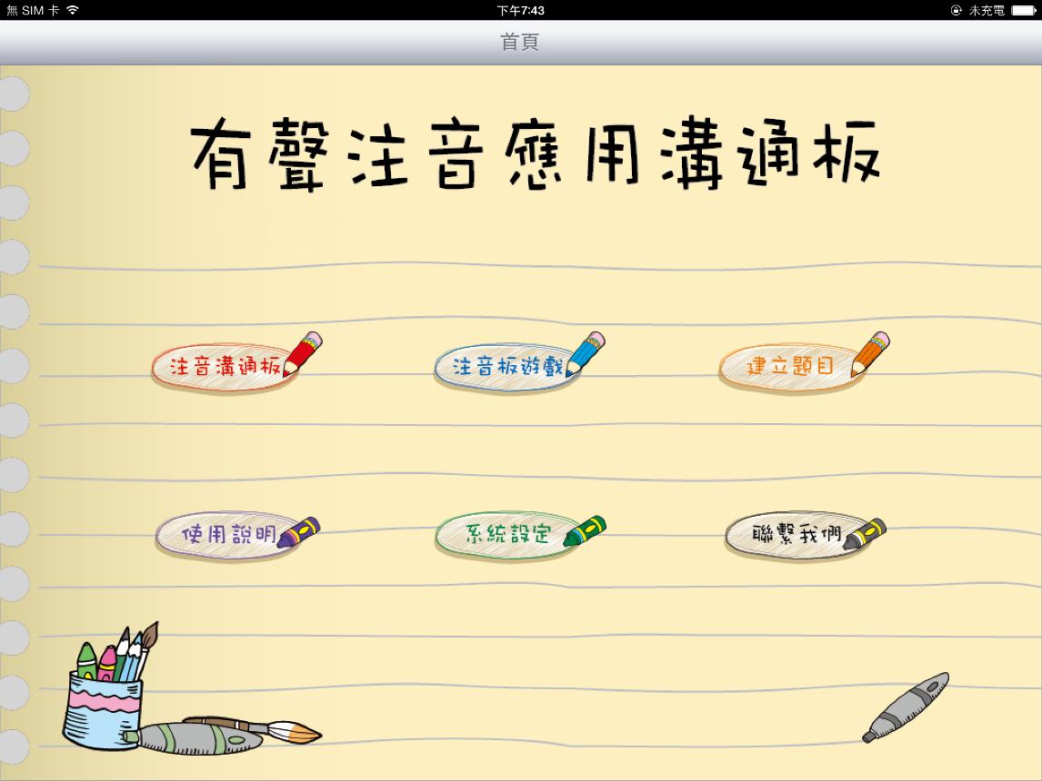

Introduction
Based on the above analysis, we have developed aid solves the problem.
And it is free.
Notes:
Because of these problems
we developed a software to help solving these problems
And it is free.

Slide 10
Method

Slide 11
Method
In this study, a Mandarin-phonetic-symbol communication aid named as zhuyin communication board is developed.
The most important function is the communication.

Slide 12
Method
Video
http://youtu.be/85U1Fl2PXis
Notes:
When the child click button "ㄗ",
The button of "ㄗ" is enlarged on the keyboard.
If you are sure of typing the character"ㄗ".
you can press the same button again.
After entering the symbol,
Press the pronunciation button will produce a corresponding audio

Slide 13
Results & Conclusions

Slide 14
Results & Conclusions
Advantages of zhuyin communication board :
Assist autistic children to express their thought to others.
The double click function is an useful design.
The quiz game can help autistic children to learn phonetic symbols.
Notes:
Zhuyin communication board has the following benefits
Help children express a message to others
double click function is an useful design.
Quiz games can help children learn.
You can use the familiar images of children to custom quiz game
Aid Chinese interface and downloads for free.

Slide 15
Results & Conclusions
Advantages of zhuyin communication board :
The editing function of quiz use pictures are familiar to autistic children.
We use Chinese as the interface of our aid.
This aid is free download in App store.
Notes:
Zhuyin communication board has the following benefits
You can use the familiar images of children to custom quiz game
Aid Chinese interface and downloads for free.

Slide 16
Results & Conclusions
Improve the shortcomings of traditional paper keyboard.
A robotic bear can increase the interest and motivation of children to use aid.
Notes:
Save a lot of problems
Bear is a very good communication interface.

Slide 17
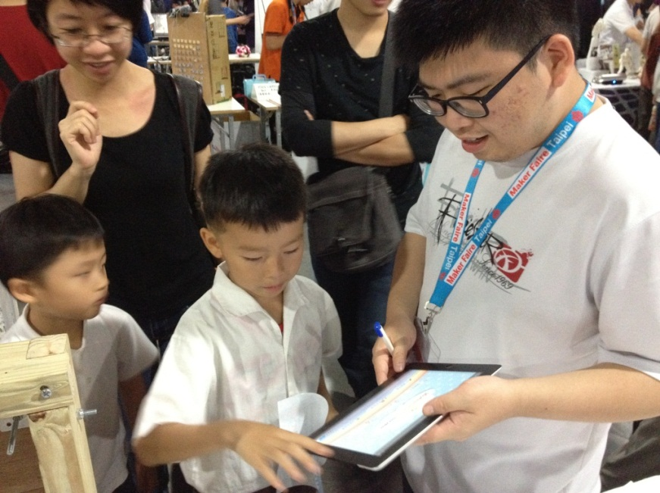
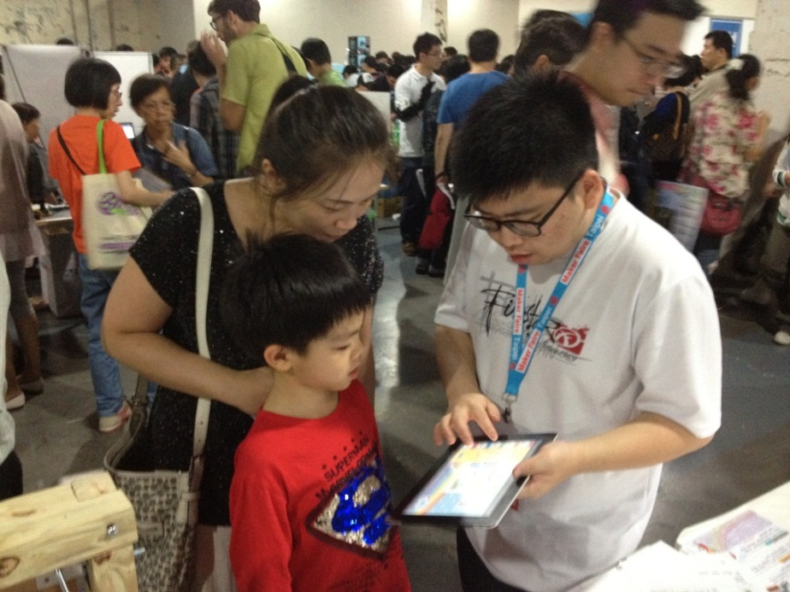
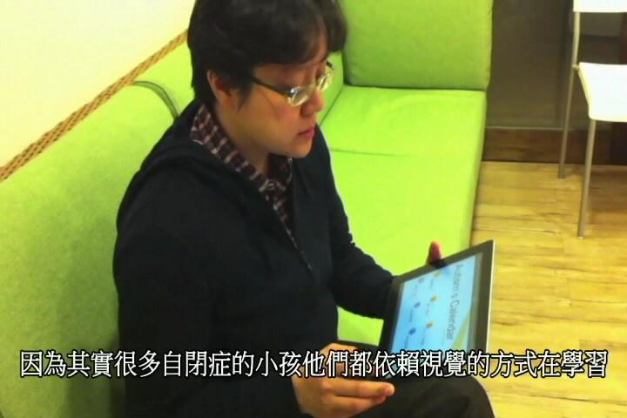
Results & Conclusions
Our aid has tested by a doctor and two parents of autistic children.

Slide 18
Download Link
The Zhuyin communication board is available in the iTunes App Store for free download,
Zhuyin communication board [Online]. Available: https://itunes.apple.com/tw/app/you-sheng-zhu-yin-ying-yong/id670857938?l=zh&mt=8
The source code of AustimSpace is also provided as open source
Source code of Zhuyin communication board [Online]. Available: http://mail.tku.edu.tw/chchou/CILAB/Research_result/Zhuyin.html
Notes:
If you need source code.
We offer a download link.
Of course, it is also free.

Slide 19
Thanks for your attention

